Slide 1
Interaction vs. Moderation
Quite often you will see moderation illustrated as below:
Preparation
Exam Grade
Anxiety

Slide 2
Interaction vs. Moderation
Quite often you will see moderation illustrated as below:
Anxiety
Exam Grade
Preparation

Slide 5
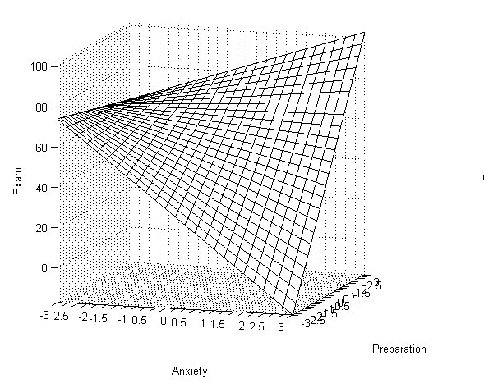
Regression Analysis

Slide 6
Median Split Quotes
Applied Multiple Regression/Correlation Analysis for the Behavioral Sciences Cohen et al., 2003 (p. 256)
“This dichotomization strategy is ill-advised, and we strongly recommend against it … Carrying out median splits on two continuous variables X and Z can produce spurious main effects when the dichotomized data are analyzed, although the effects do not in fact exist in the population.”
Multiple Regression, Aiken & West (1991) (p.4)
“This practice does allow data to be subject to the familiar procedures of a 2x2 factorial ANOVA. Unfortunately, this practice is also associated with substantial costs. Median splits of continuous variables throw away information, reducing the power of the statistical test: They make it much more difficult to detect significant effect when in fact they do exist”
Multiple Regression in Behavioral Research (3rd Edition), Pedhazur (1997), p.577
“It is this loss of information about differences among subjects, or reduction of the variability of the continuous variable, that leads to a reduction in the sensitivity of the analysis, not to mention the meaningfulness of the results.”
Regression Analysis for Categorical Moderators, Aguinis (2004), p. 75
“In sum, researchers should not use procedures such as a median split to artificially create subgroups based on a variable measured using a continuous scale. In most cases, this is likely to reduce the chances of detecting a moderating effect, and in others it may lead to an increase in Type I error rates. In all cases, however, artificial polichotomization of continuous variables is likely to lead to incorrect substantive conclusions regarding the presence of a moderating effect.”

Slide 7
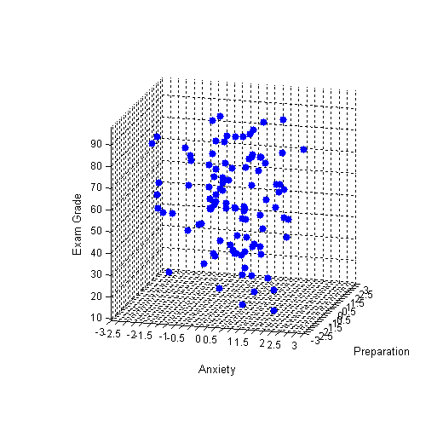

Slide 8
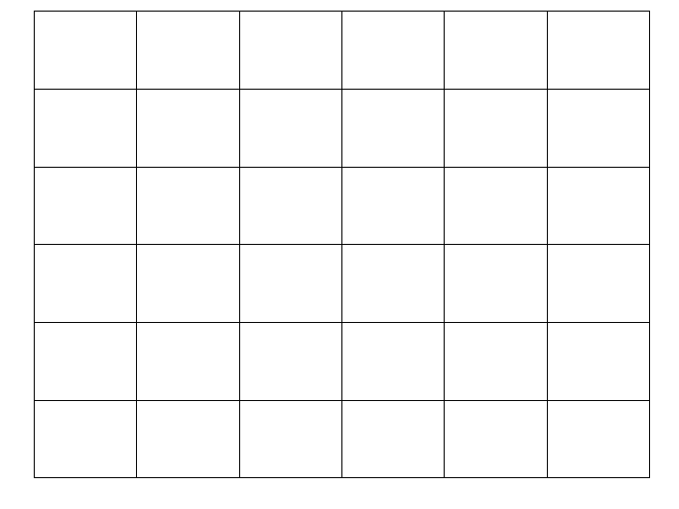
(Preparation)
(Anxiety)

Slide 9
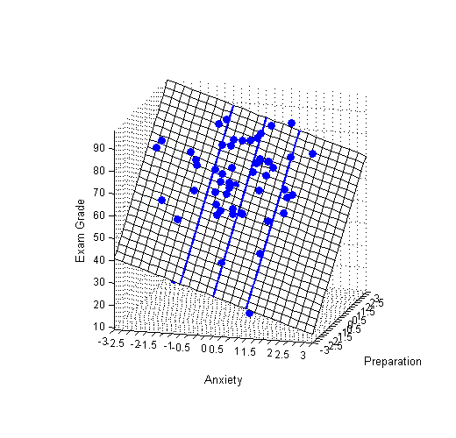

Slide 10
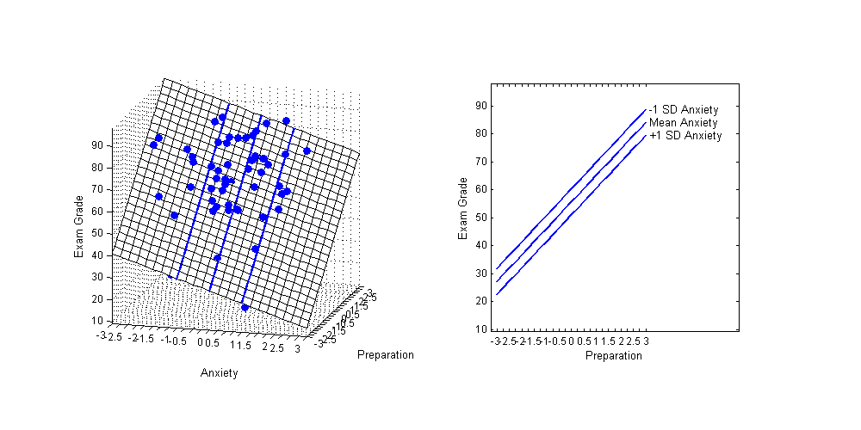
These lines are referred to as Simple Regression lines. They are calculated by holding one of the predictors constant (in this case Anxiety).
Notice how the slope of the line is the same regardless of the level of Anxiety (X). Only the value of the intercept changes.

Slide 11
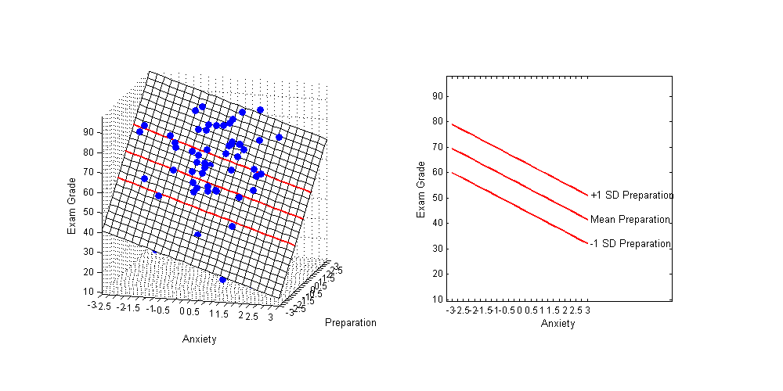
These lines are referred to as Simple Regression lines. They are calculated by holding one of the predictors constant (in this case Preparation).
Notice how the slope of the line is the same regardless of the level of Preparation(Z). Only the value of the intercept changes.

Slide 12
(Preparation)
(Anxiety)

Slide 13
Regression Analysis

Slide 14
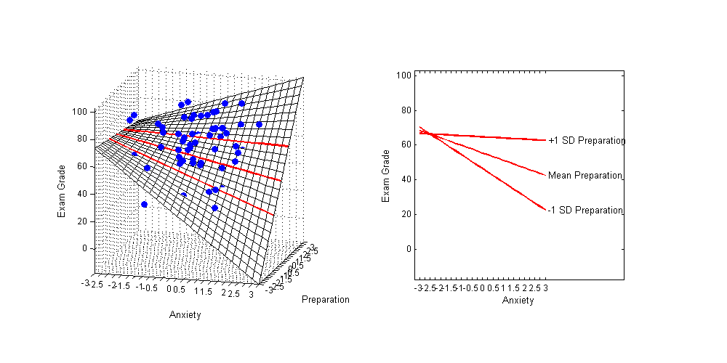
Regression Analysis
The significant interaction term indicates that the slopes of the simple regression lines vary. That is, the relation between Anxiety (X) and Exam Grades (Y) varies with the different levels of preparation. Similarly, the relation between Preparation (Z) and Exam Grades (Y) varies with the different levels of Anxiety.
Simple Regression Lines

Slide 15
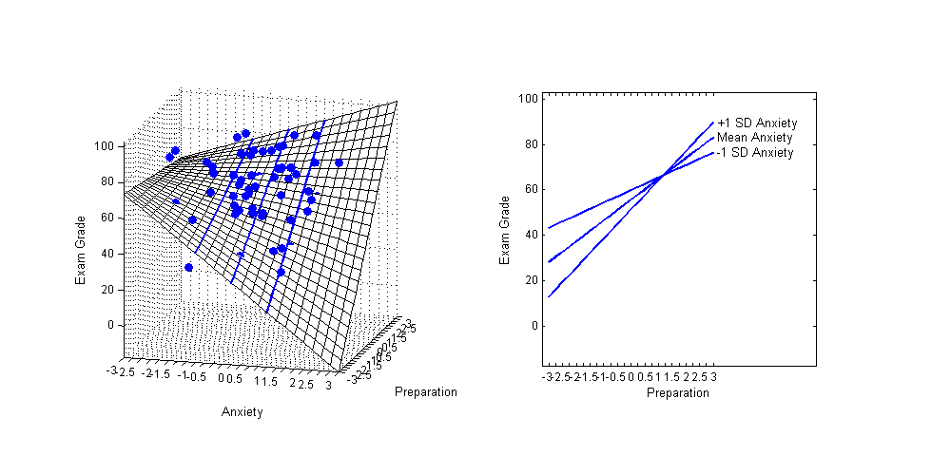
Regression Analysis
The significant interaction term indicates that the slopes of the simple regression lines vary. That is, the relation between Anxiety (X) and Exam Grades (Y) varies with the different levels of preparation. Similarly, the relation between Preparation (Z) and Exam Grades (Y) varies with the different levels of Anxiety.
Simple Regression Lines

Slide 16
Rube Goldberg

Slide 17


Slide 18
Mediation
Mediator
a
b
IV
DV
c
See Howell description of mediation

Slide 19
Mediation
Time Spent Studying
a
b
Academic Motivation
Exam Grade
c
See Howell description of mediation

Slide 20
Full Mediation (IV only has an indirect effect on DV)
Time Spent Studying
a
b
Academic Motivation
Exam Grade
See Howell p. 527

Slide 21
Partial Mediation (IV has direct and indirect effect on DV)
Time Spent Studying
a
b
Academic Motivation
Exam Grade
c
See Howell p. 527

